Slide 1
NEW LIFE CENTER
TEAM 06
Shivani Datar
Shivani Guglani
Kartik Sharma

Slide 2
TABLE OF CONTENTS
01.
PROBLEM STATEMENT
02.
SOLUTION
03.
ENTERPRISES AND ORGANIZATION
04.
OBJECT MODEL
05.
ROLES
06.
ADVANCE FEATURES
07.
USER INTERFACE
08.
SCOPE

Slide 3
01.
PROBLEM STATEMENT

Slide 4
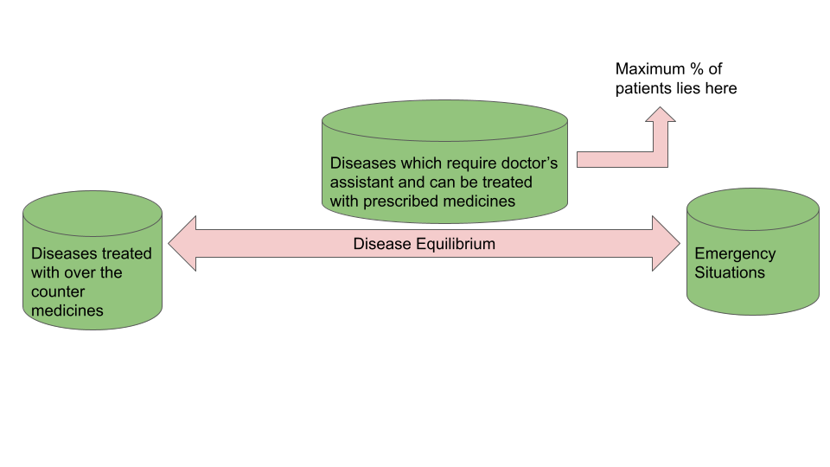
PROBLEM STATEMENT
Majority of the patients lie between the disease equilibrium.
The wait time for availability of appointments is excessive.
Payment queues are lengthy.
This entirely makes it a risky situation for the patient and the chances of increment in infection. For the patient, there is excessive hard work and exertion involved.

Slide 5
02.
SOLUTION

Slide 6
SOLUTION
ONLINE CONSULTATION
ONLINE INSURANCE CLAIMS
LESS WAIT TIME
EMERGENCY SERVICES
Patients can book appointments online.
Patient have online form to submit the insurance claims online
There is no wait time as the consultation is online at patient’s convenience
In case of emergency services, they can book emergency request

Slide 7
03.
ENTERPRISES AND ORGANIZATIONS

Slide 8
ENTERPRISES AND ORGANIZATIONS
HOSPITAL
PHARMACY
PHARMACEUTICAL
INSURANCE BODY
DOCTOR ORG
RECEPTIONIST
AMBULANCE
LAB ASSISTANT
ACCOUNTANT
PATIENT
DELIVERYMAN
PHARMACY ORG
INSURANCE ORG
PHARMACEUCAL
ORG

Slide 9
04.
OBJECT MODEL

Slide 10
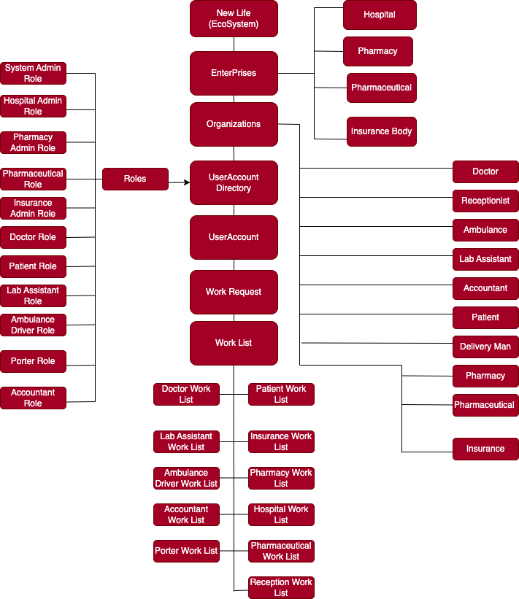
OBJECT MODEL
An authentication for login is performed based on comparison from the role’s login and password within the User Account Directory.
All the work requests for all the roles are stored in WorkList class. Every time while pushing a new work task, we set the sender and receiver in the work request object, which helps the role to access tasks in their respective work areas.
Some roles have upper hand as they can create more roles than others:
System Admin Role : Can create hospital admin, pharmacy admin, pharmaceutical admin or insurance admin
Hospital Admin : create the whole hospital staff

Slide 11
OBJECT MODEL
The Pharmacy Admin can create varying medicines and add inventory for them.
Hospital Admins are capable of booking lab requests by selecting a particular lab personnel and can also respond to the emergency requests.
The Lab Role can work on patient lab bookings and help on completion of a work form.
The Doctor is capable of attending to patient appointments.
The Insurance Admin can look at Patient records and claims, can accept or decline the claims made by the patients and download patient records.

Slide 12
05.
ROLES

Slide 13

ROLES
SYSTEM ADMIN
HOSPITAL ADMIN
DOCTOR
RECEPTIONIST
LAB ASSISTANT
ACCOUNTANT
PATIENT
DELIVERYMAN
PHARMACY ADMIN
INSURANCE ADMIN
AMBULANCE DRIVER

Slide 14
06.
ADVANCE FEATURES

Slide 15


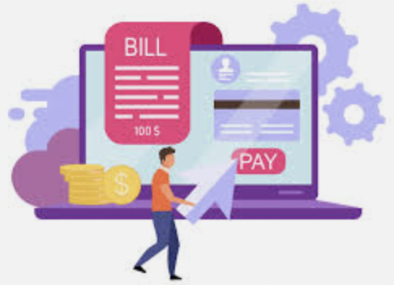

ADVANCE FEATURES
Receive a zoom meeting invite with doctor via email
Insurance Admin can download the patient records as a pdf
Receive the lab test results by email
Receive receipt by email

Slide 16

07.
USER INTERFACE

Slide 17
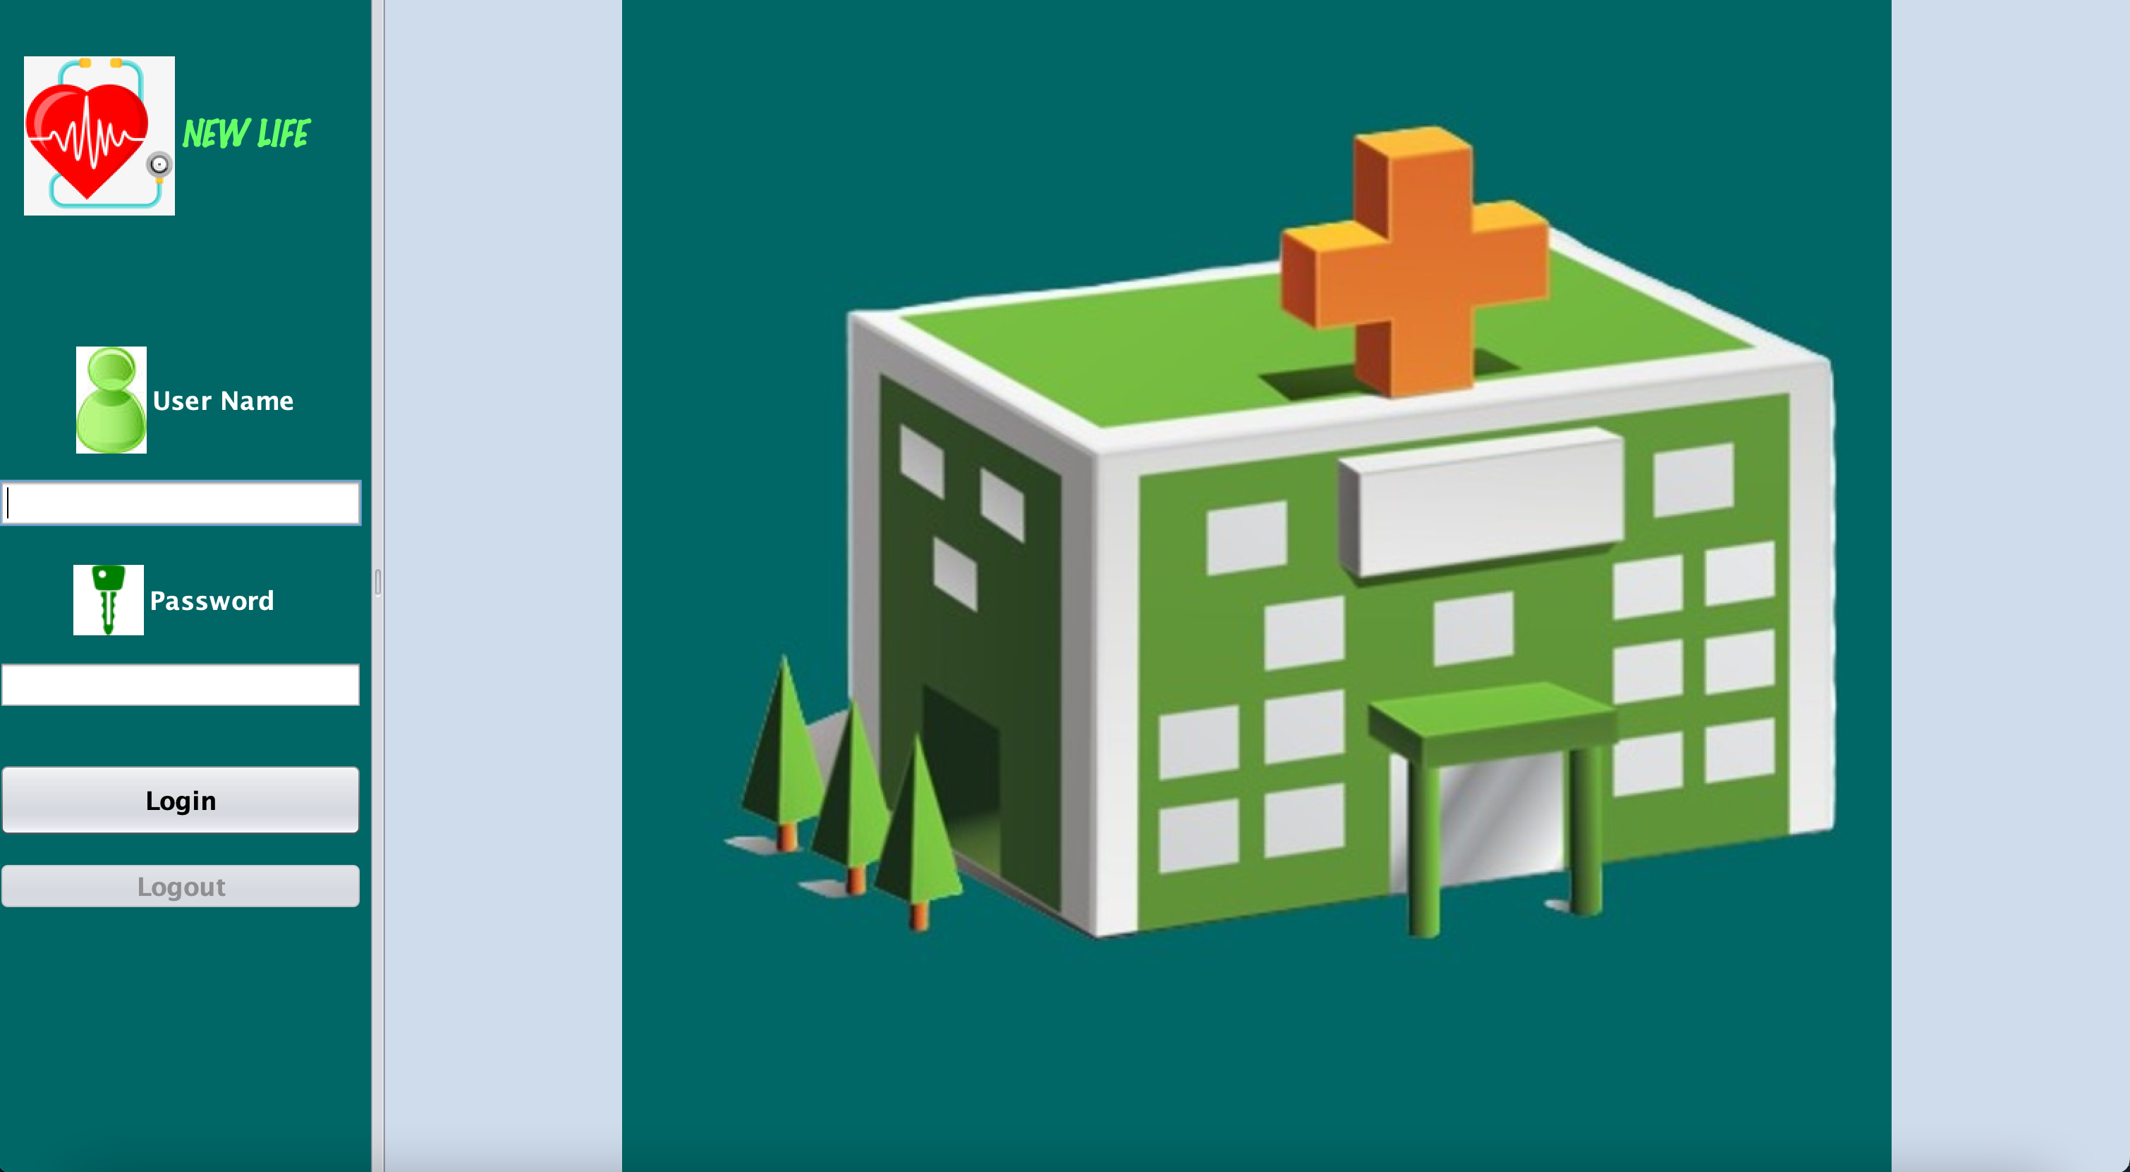
USER INTERFACE

Slide 18
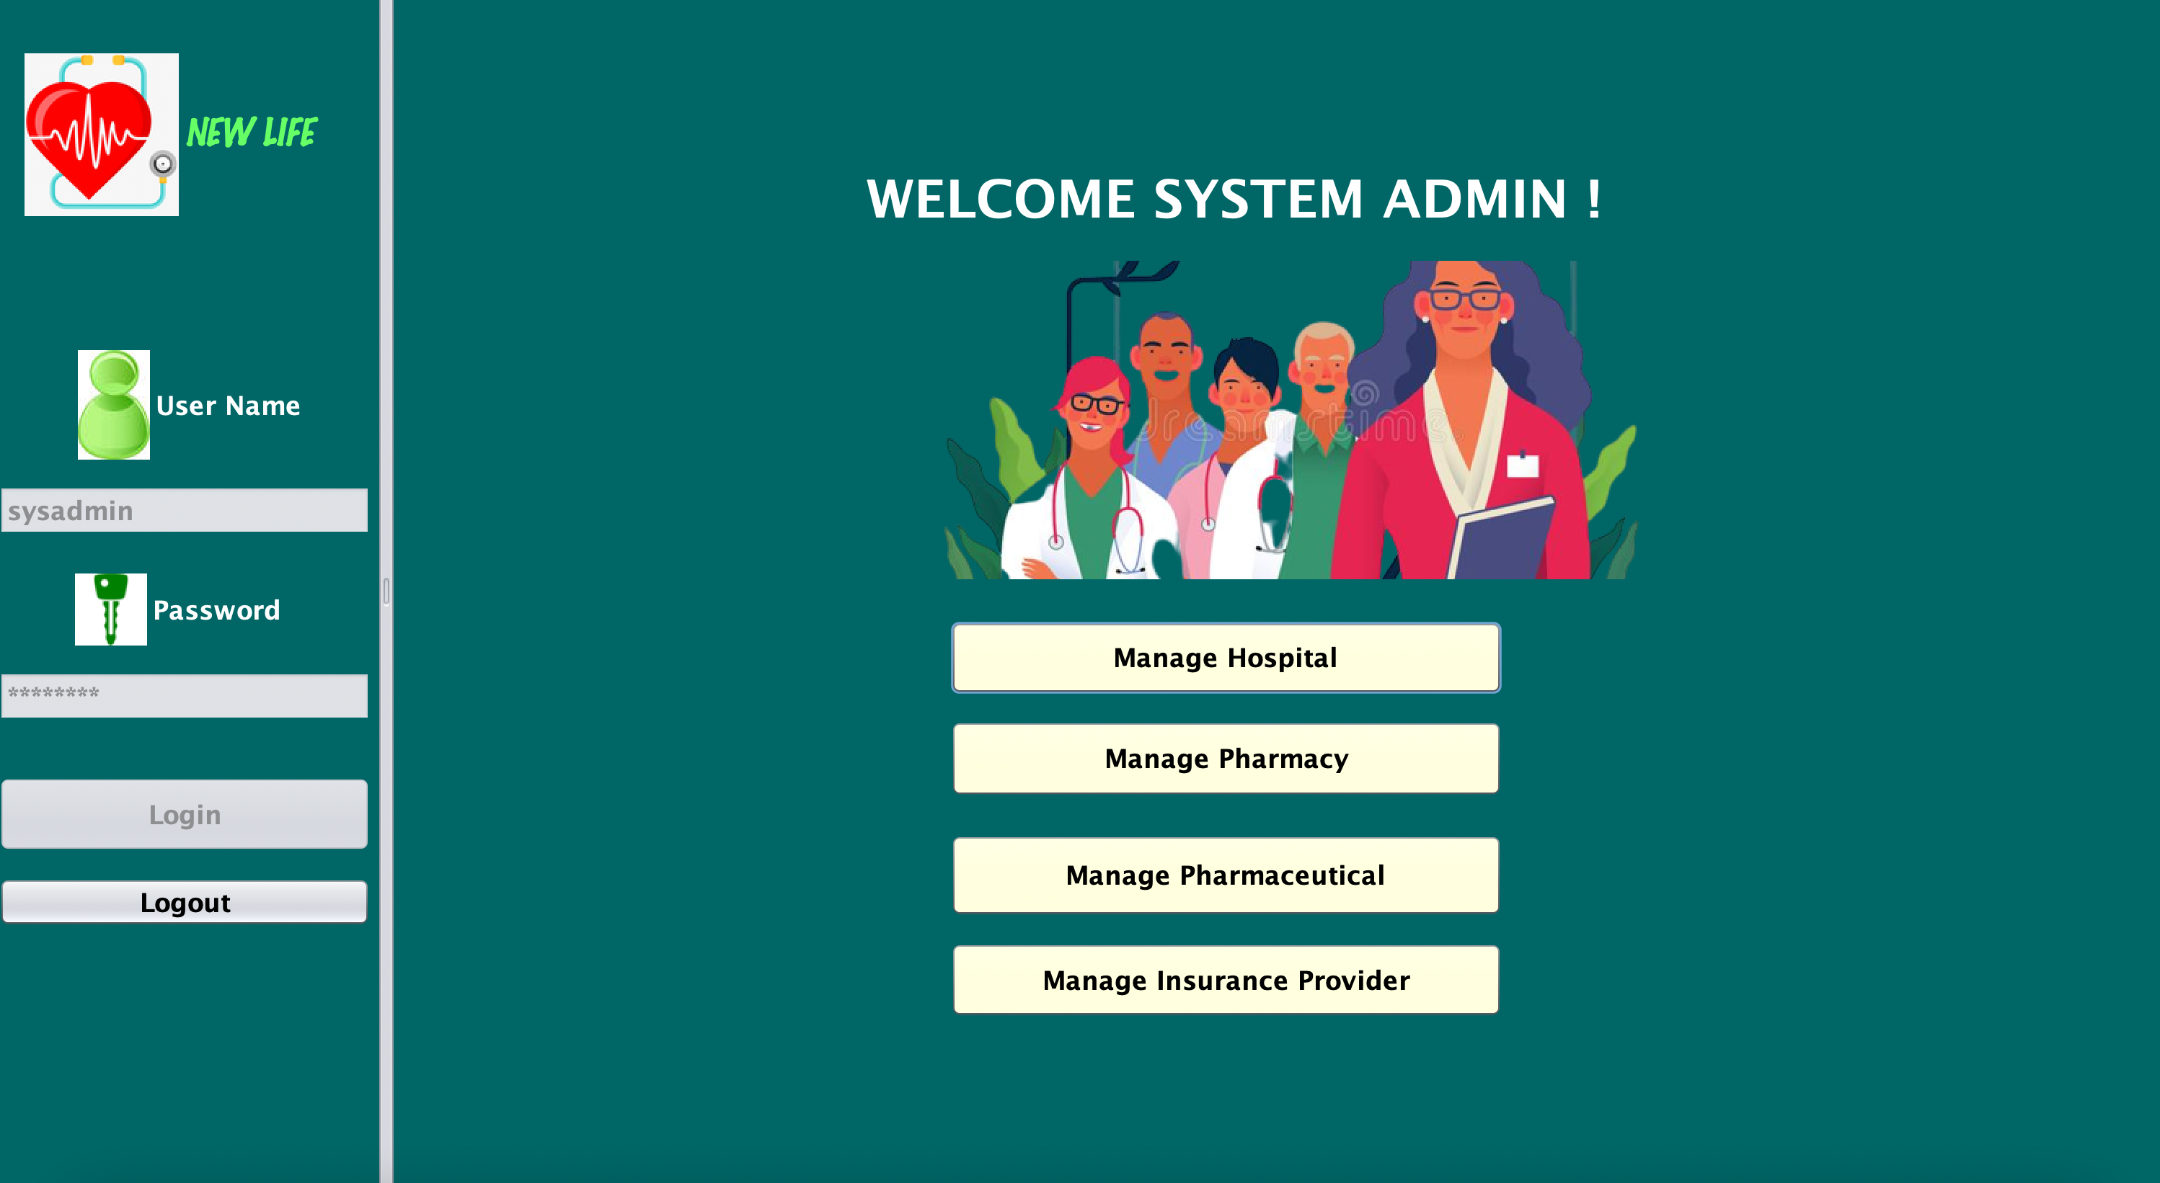
USER INTERFACE

Slide 19
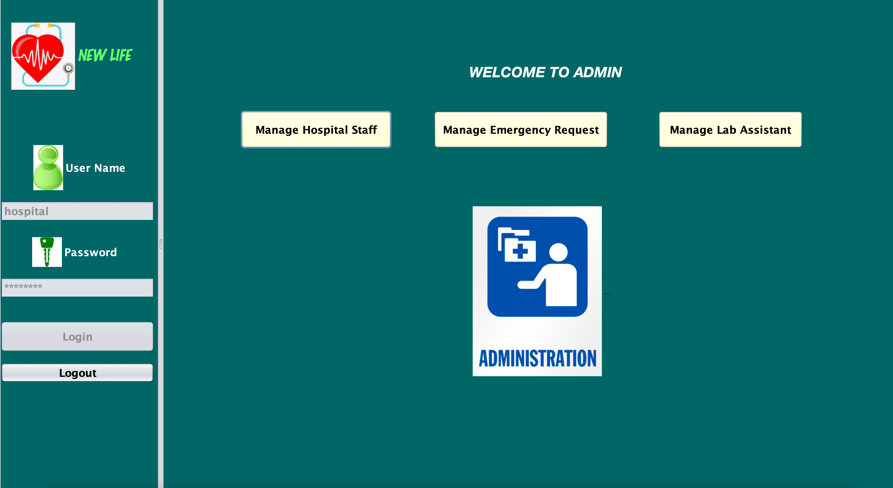
USER INTERFACE

Slide 20
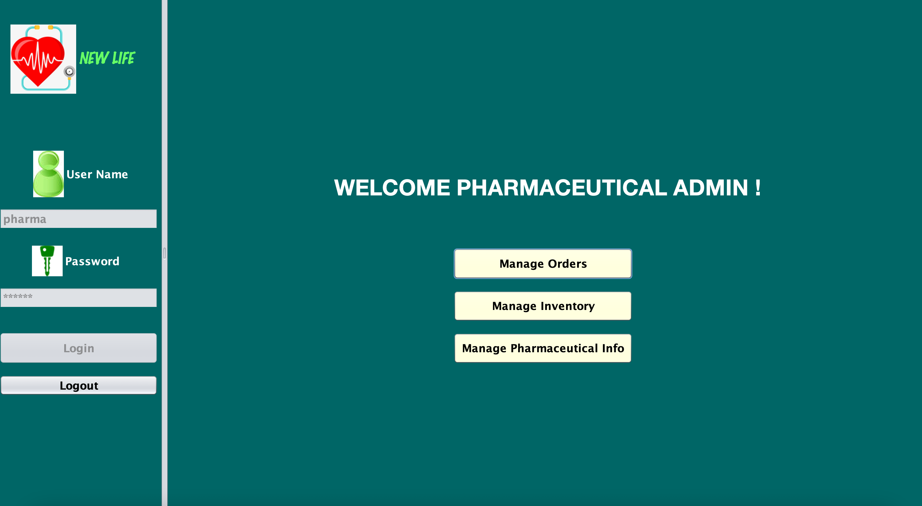
USER INTERFACE

Slide 21
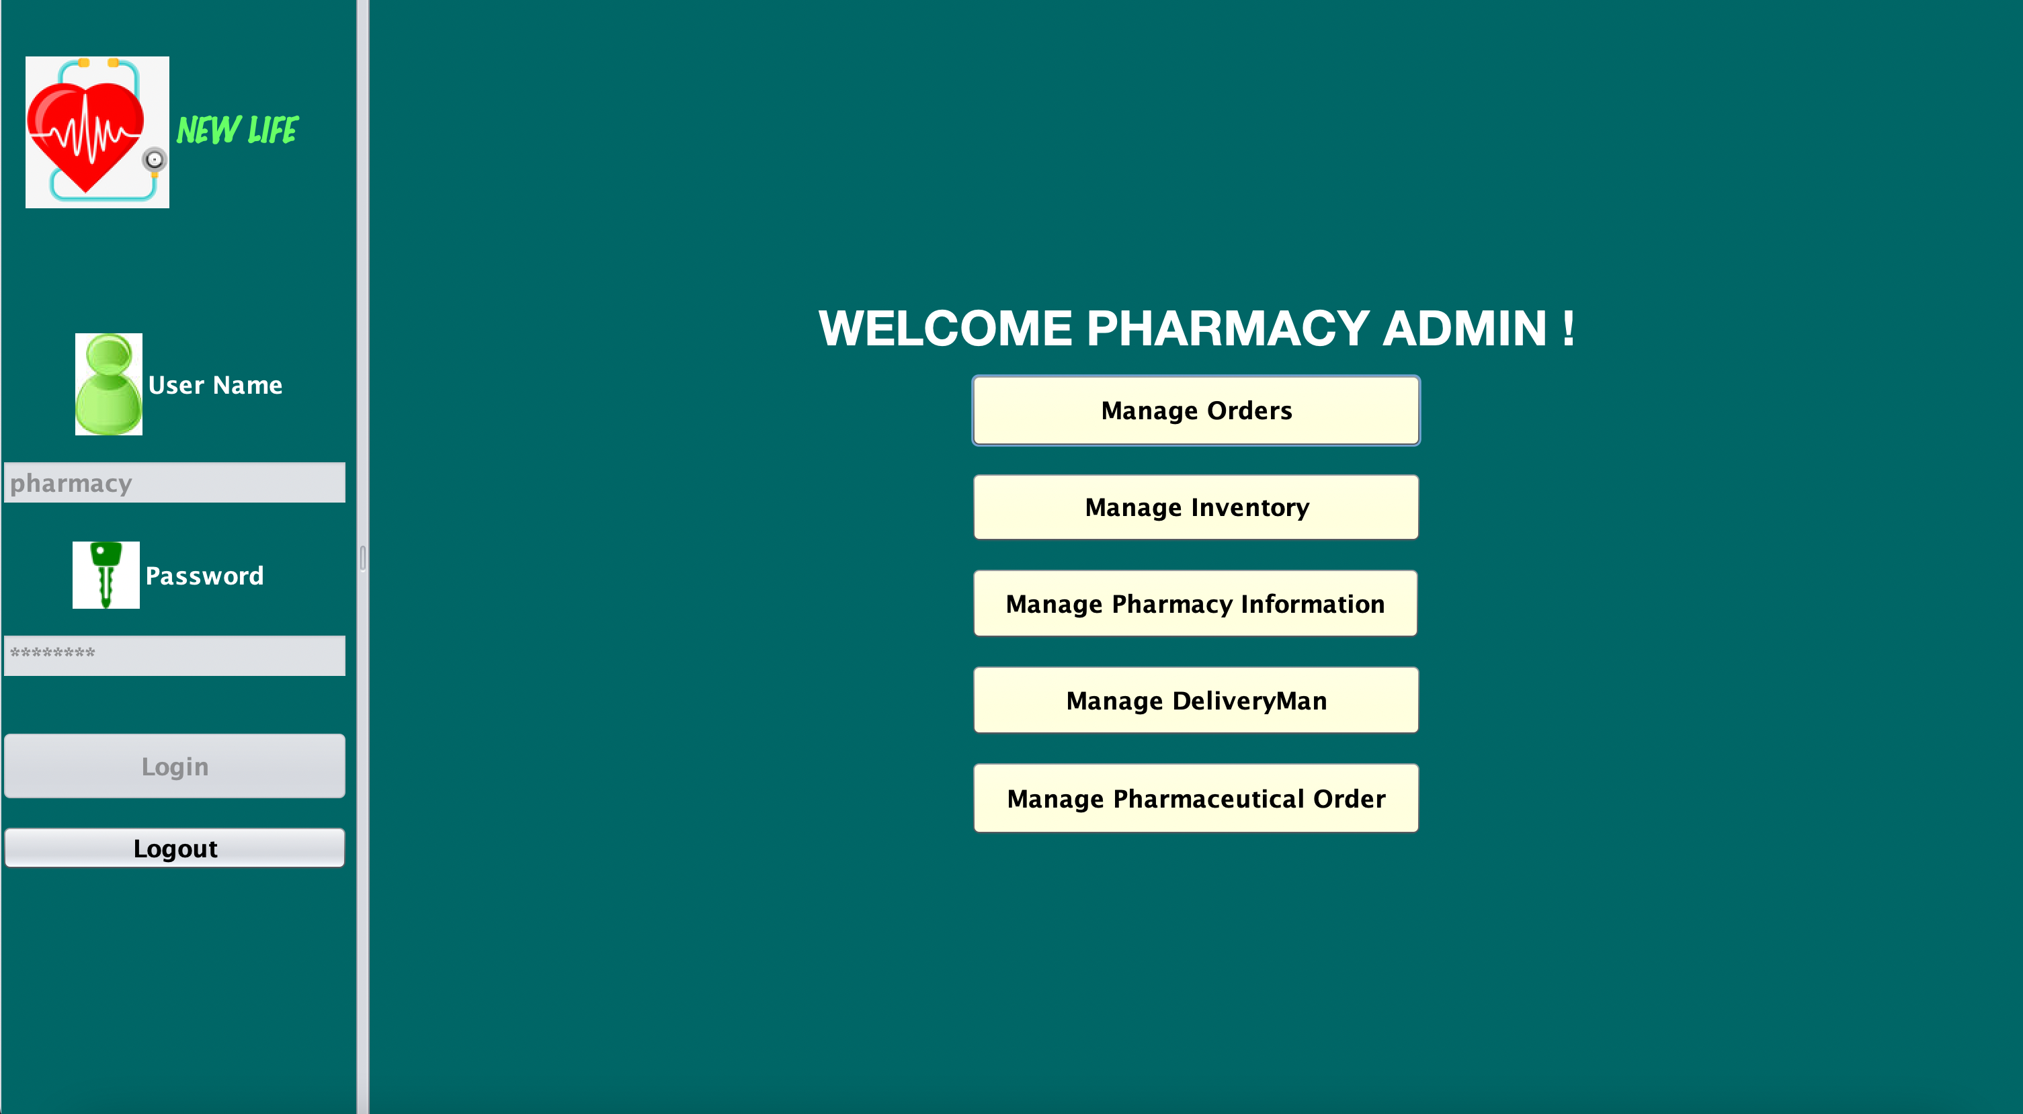
USER INTERFACE

Slide 22
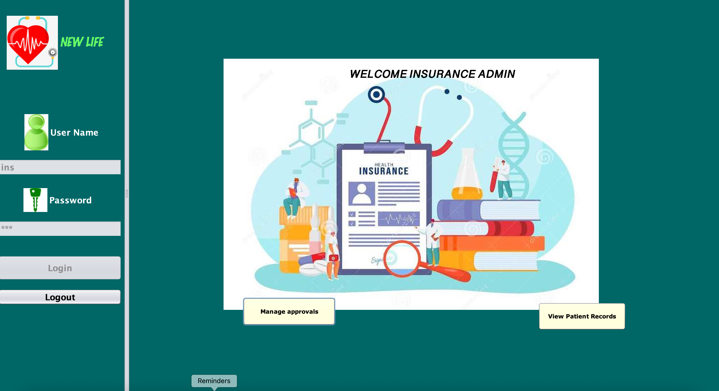
USER INTERFACE

Slide 23


08.
SCOPE

Slide 24
Power
Scalability
To solve the problems caused by medical wait times and provide ease of solutions for all.
It can be applied to hospitals and medical organizations globally.
Relevance
No matter which walk of life the individual is from, this application can be used by them.
Outreach
Will provide medical support to even the most remote locations in the world.

Slide 25
THANK YOU

